Slide 1
Python (not Monty) in SQL Server 2017 SQL Saturday #652 Atlanta, GA, July 15, 2017

Slide 2
About Me
Chris Hyde
Owner and Principal Consultant, Hydrate Consulting LLC
MCSA: SQL 2016 Business Intelligence Development
16+ Years experience with SQL Server
Contact Me:
Email: chris@hydrate.consulting, chrishyde325@gmail.com
Twitter: @ChrisHyde325

Slide 3
Agenda
A brief warning!
Python in SQL 2017 overview
Installation and configuration
Getting data into and out of Python
Real-world use cases

Slide 4

Before we begin…

Slide 5
Machine Learning Services
2015 – Microsoft acquires Revolution Analytics
SQL Server 2016 – SQL Server R Services
SQL Server 2017 – Machine Learning Services

Slide 6
Anaconda Distribution
Distribution of Python focused on data science
Package and environment manager
Installs with more than 100 packages
As of SQL 2017 CTP 2.1: Python version 3.5.2

Slide 7
Popular Data Science Packages
NumPy – N-dimensional arrays, random numbers
pandas – Data manipulation, DataFrame object
SciPy – scientific computing and statistical methods
scikit-learn – machine learning
matplotlib – plotting and graphics

Slide 8
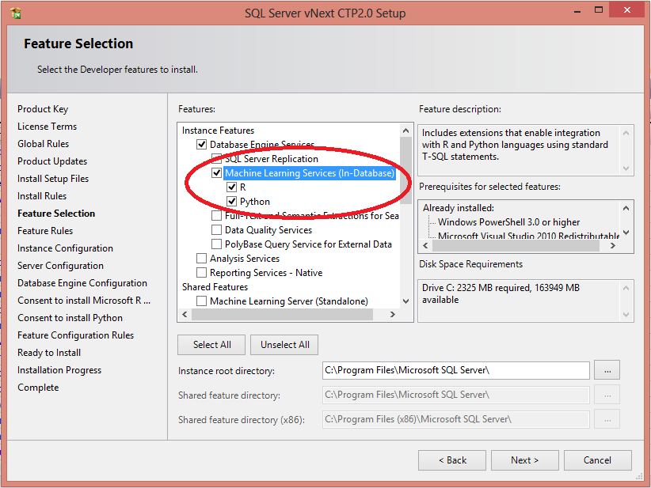
Installing Machine Learning Services, part 1

Slide 9
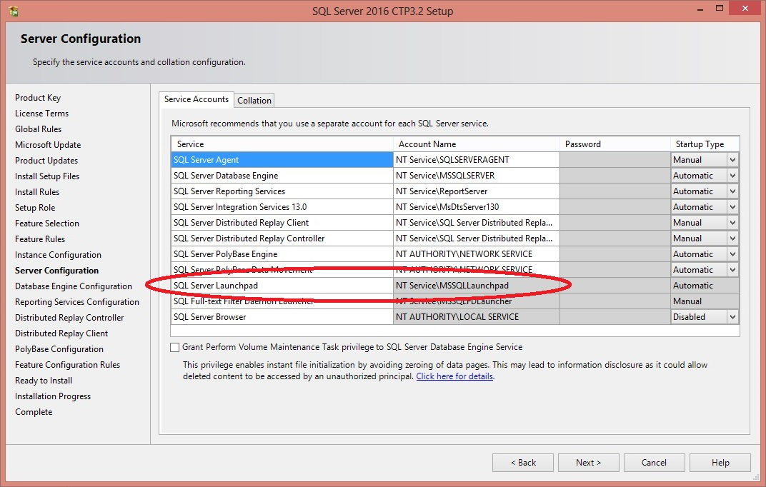
Installing Machine Learning Services, part 2

Slide 10
Installing Machine Learning Services, part 3
Post-installation scripts and configuration
1. Enable external scripts
EXEC sp_configure 'external scripts enabled', 1;
RECONFIGURE;
2. Configure memory appropriately

Slide 11
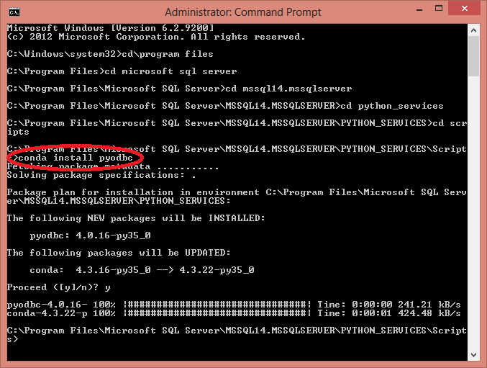
Installing New Packages

Slide 12
Getting Data Into and Out Of Python
Demo #1

Slide 13
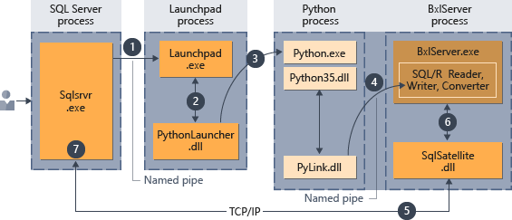
Python in SQL Server Architecture

Slide 14







The Case Studies (Slightly Fictionalized)
My Fictional Hospital
MFH

Slide 15
A Real-World Example
Demo #2: Averting panic over a charge summary report

Slide 16
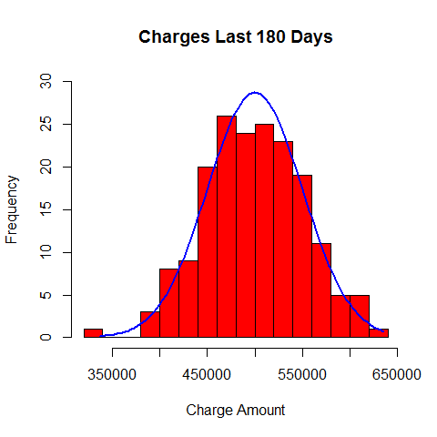
Distribution of Charges

Slide 17
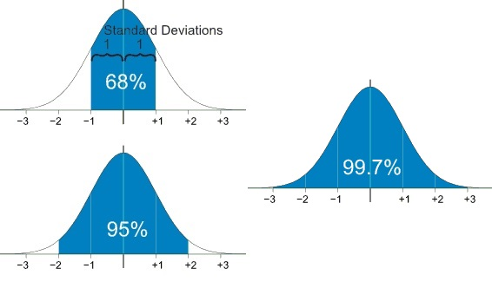
Reviewing Standard Normal Distribution
Source: https://www.mathsisfun.com/data/standard-normal-distribution.html

Slide 18
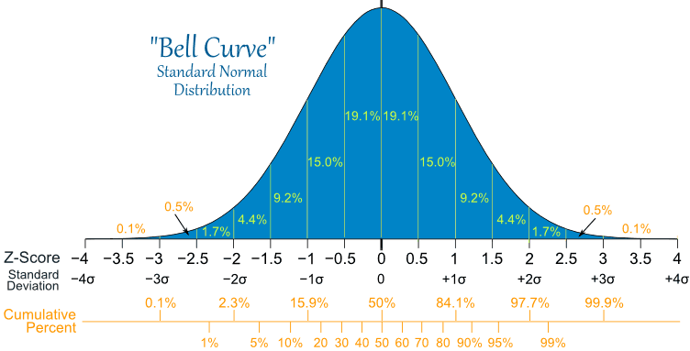
Standard Normal Distribution in Detail
Source: https://www.mathsisfun.com/data/standard-normal-distribution.html

Slide 19

Standard Deviation Formula
Source: https://www.mathsisfun.com/data/standard-deviation-calculator.html

Slide 20
A More Complicated Real-World Example
Demo #3: Overbooking without over-overbooking

Slide 21
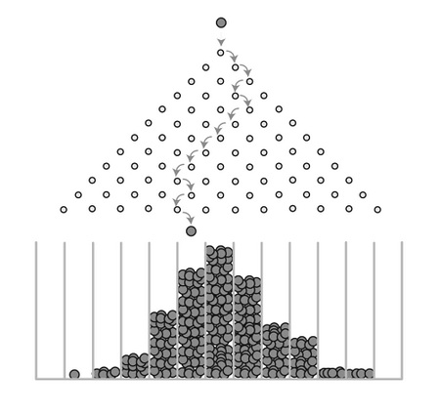
Galton Board

Slide 22
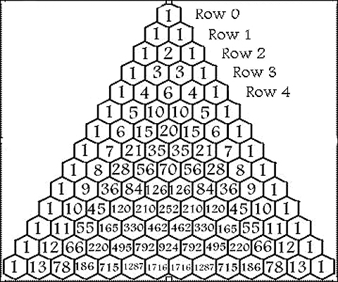
Pascal’s Triangle

Slide 23
Resources and Next Steps
This Presentation:
https://github.com/Drjekyll325/SQLServer/tree/master/Presentations
Microsoft Data Exploration and Predictive Modeling Tutorial:
https://docs.microsoft.com/en-us/sql/advanced-analytics/tutorials/sqldev-in-database-python-for-sql-developers
Microsoft Professional Program Certificate in Data Science:
https://www.edx.org/microsoft-professional-program-certificate-data-science
Email Me:
chris@hydrate.consulting
chrishyde325@gmail.com

